Slide 1
AMAZON KINESIS
Yash , Vivek , Shailesh, Akash, Sunil

Slide 4
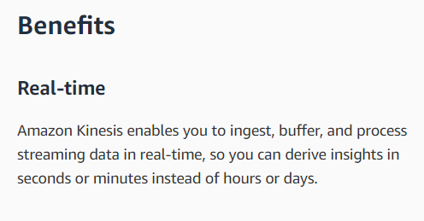
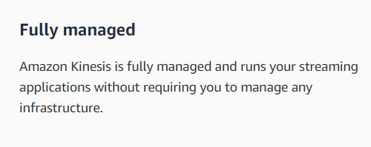
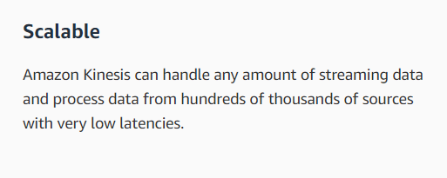

Slide 5
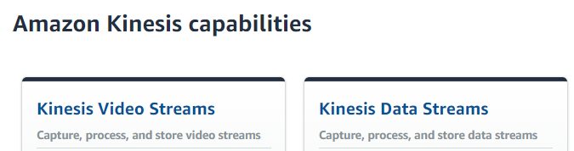
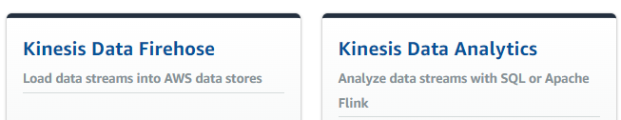

Slide 6
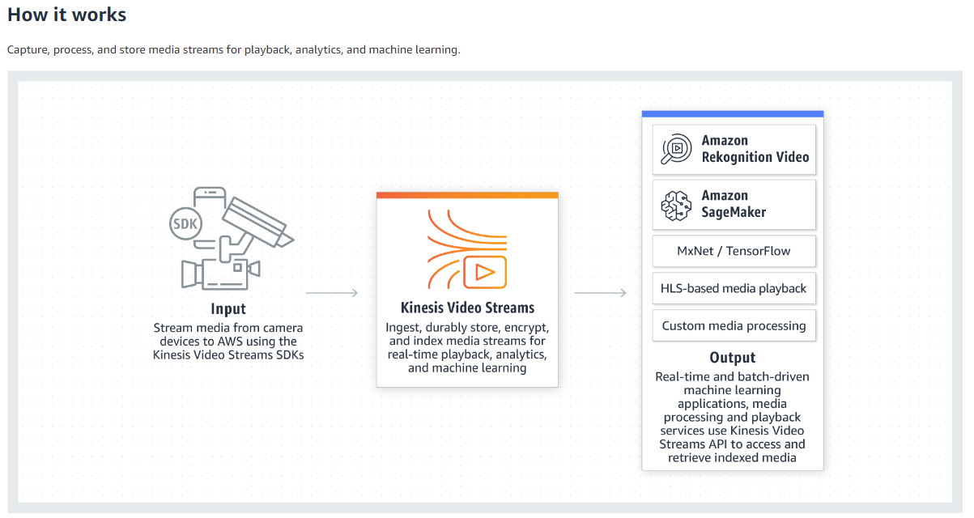
Amazon Kinesis Video Streams :

Slide 7
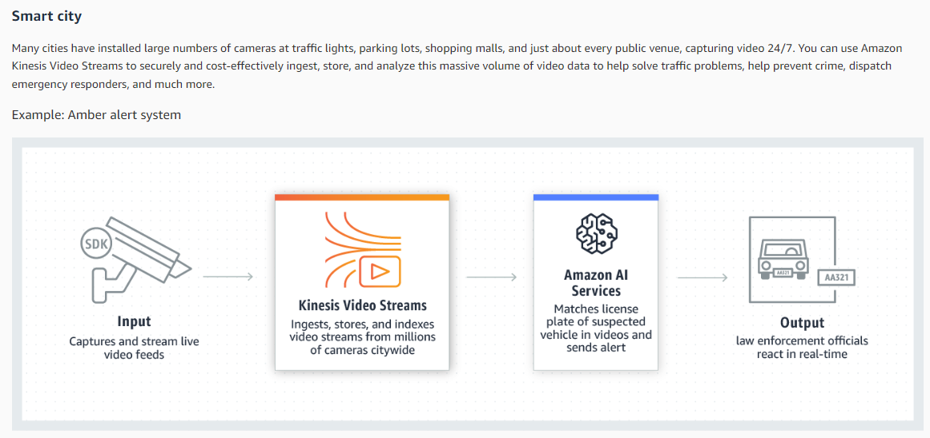
Use Case of Amazon Kinesis Video Streams :

Slide 8
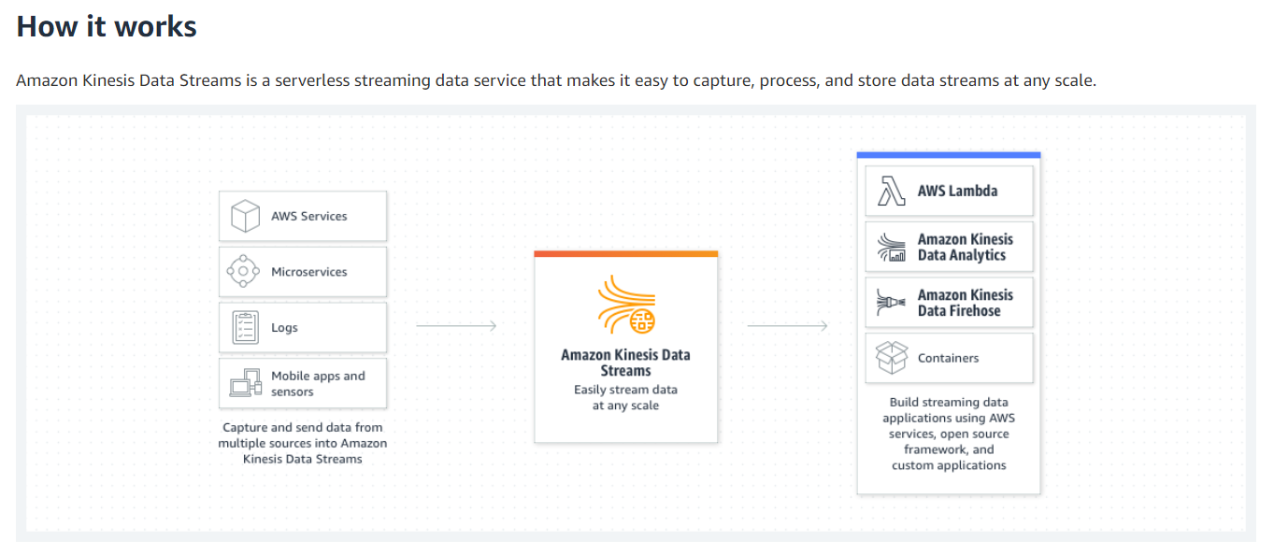
Amazon Kinesis Data Streams :

Slide 9
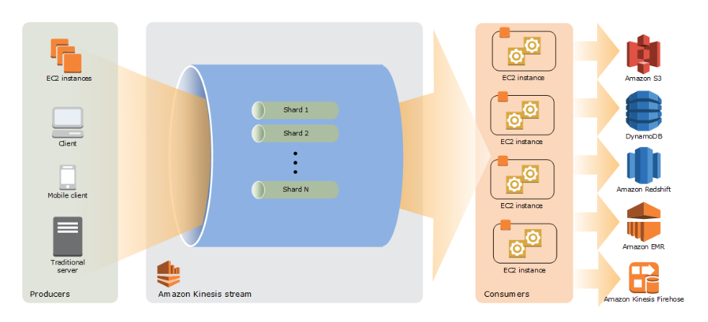
High Level Architecture of Amazon Kinesis Data Streams :

Slide 10
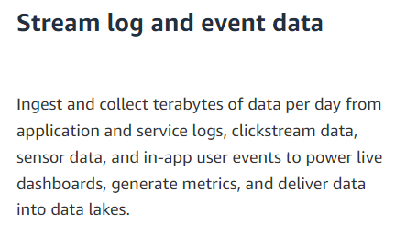
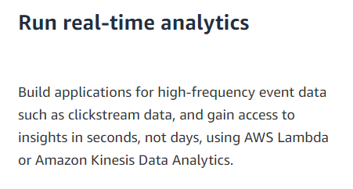
Use Case of Amazon Kinesis Data Streams

Slide 11
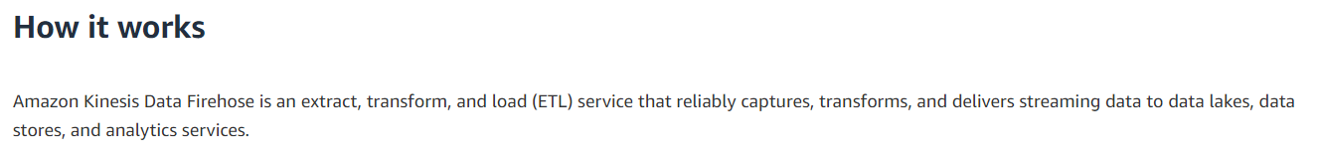
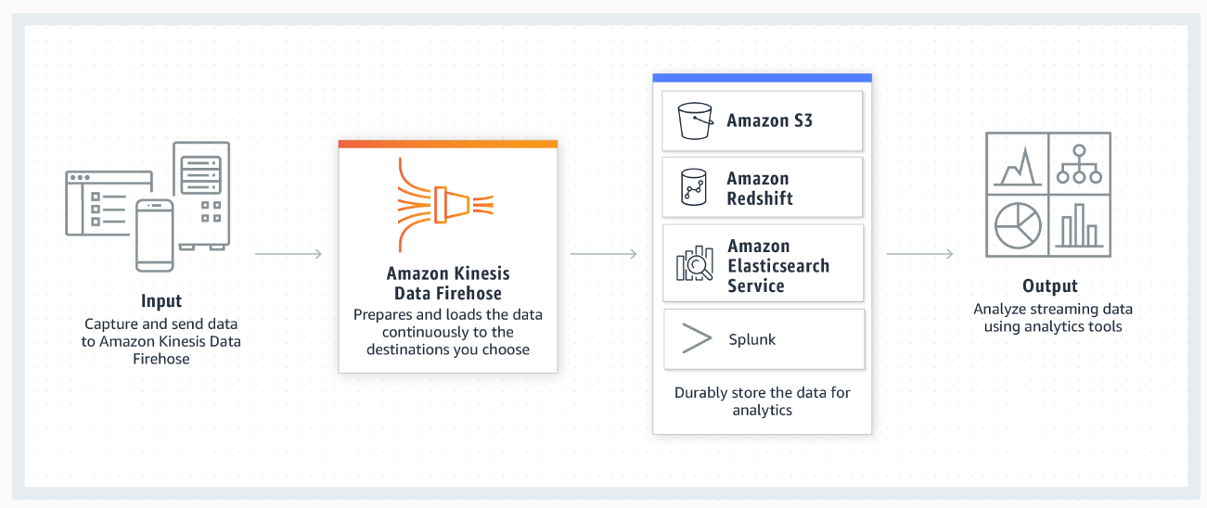
Amazon Kinesis Data Firehose :

Slide 12
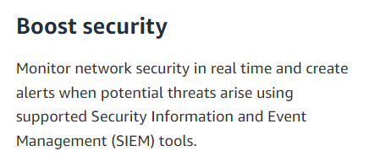
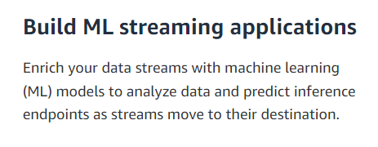
Use Cases of Amazon Kinesis Data Firehose :

Slide 13
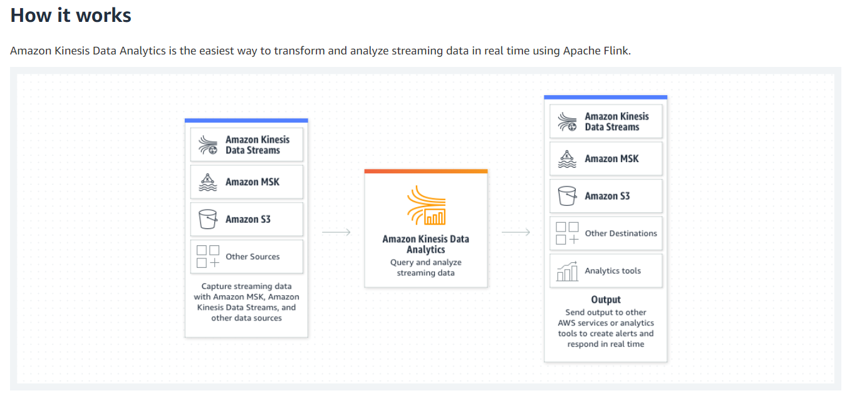
Amazon Kinesis Data Analytics :

Slide 14
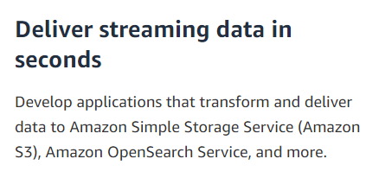
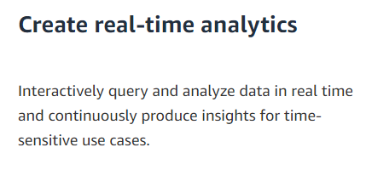
Use Cases Amazon Kinesis Data Analytics :

